Slide 1
최신 계산 유전체학 Analysis of Next generation - sequencing data
22/10/03
석사 과정생 박정준

Slide 2
목차
Part I History of Sequencing
1. Sanger sequencing
2. NGS sequencing
3. Long-read sequencing
Part II NGS data analysis
1. Definitions of terms for NGS data analysis
2. Workflow of NGS data analysis

Slide 3
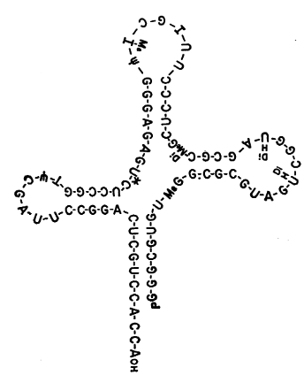

I -1. Sanger sequencing
Robert W. Holley
The first sequencing
tRNA(alanine) from yeast(1965)
Win Novel prize (1968)

Slide 4
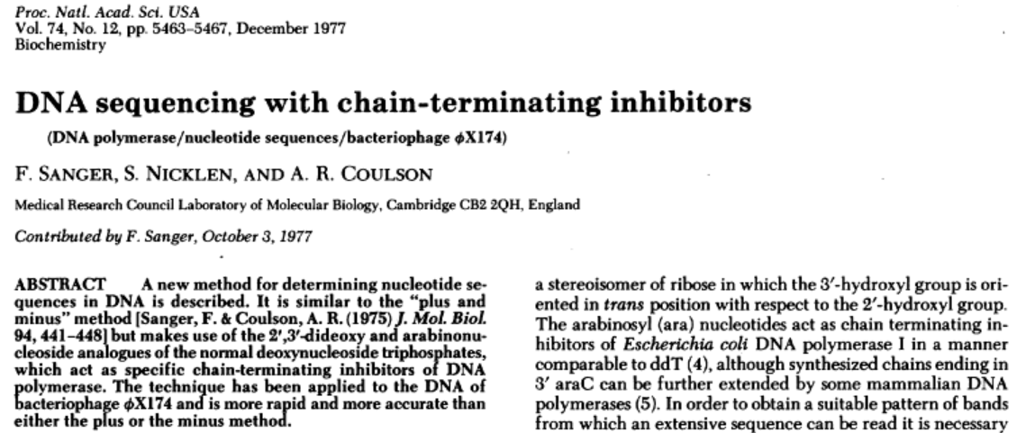
I -1. Sanger sequencing
Fredrick Sanger (1977)
Chain-termination sequencing
Dideoxynucleotide sequencing

Slide 5
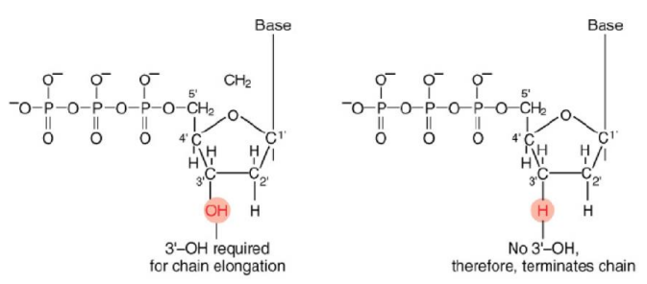
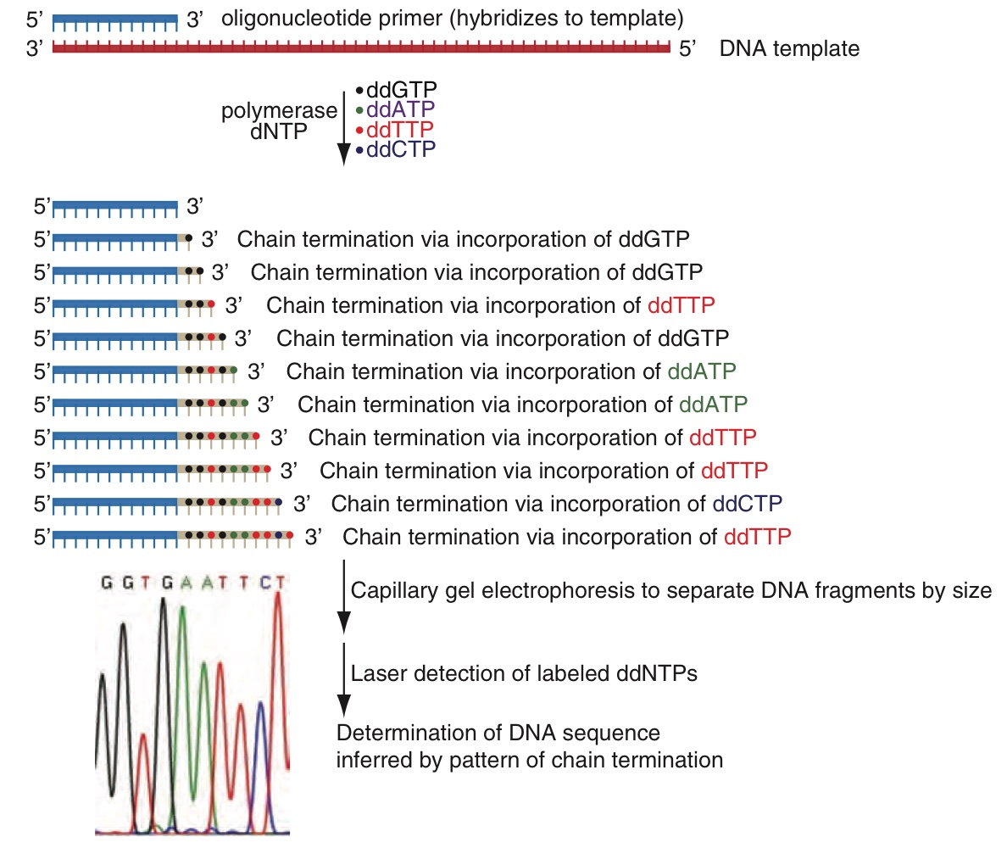
I - 1. Sanger sequencing
ddNTP terminate elongation
DNA template need to be duplicated a lot. (PCR)
Each ddNTP labeled by fluorescent

Slide 6
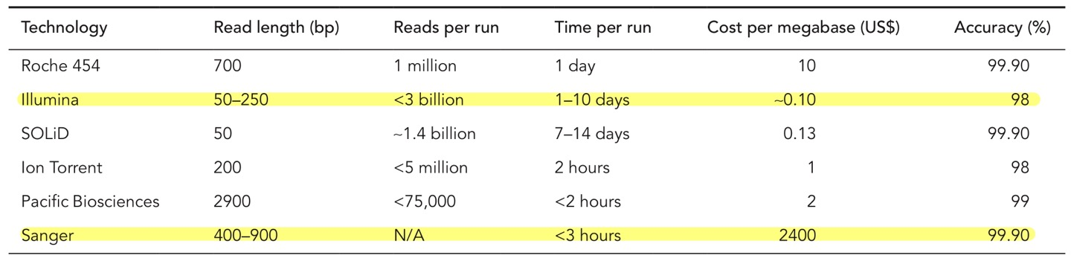
I - 1. Sanger sequencing
Advantage
Cheap for short sequence
High Accuracy(Q₃₀)
Short running time

Slide 7
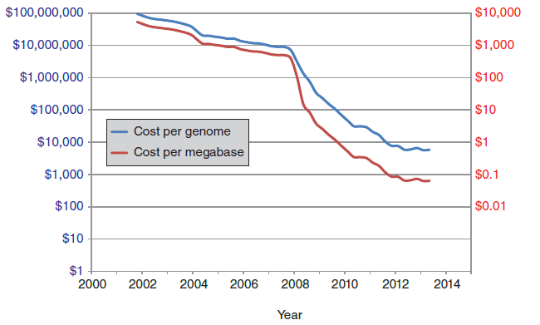
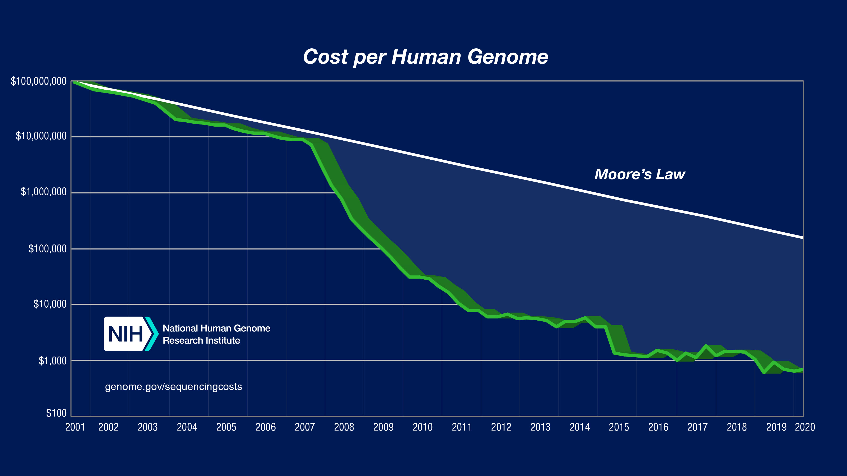
I - 2. Next generation sequencing

Slide 8
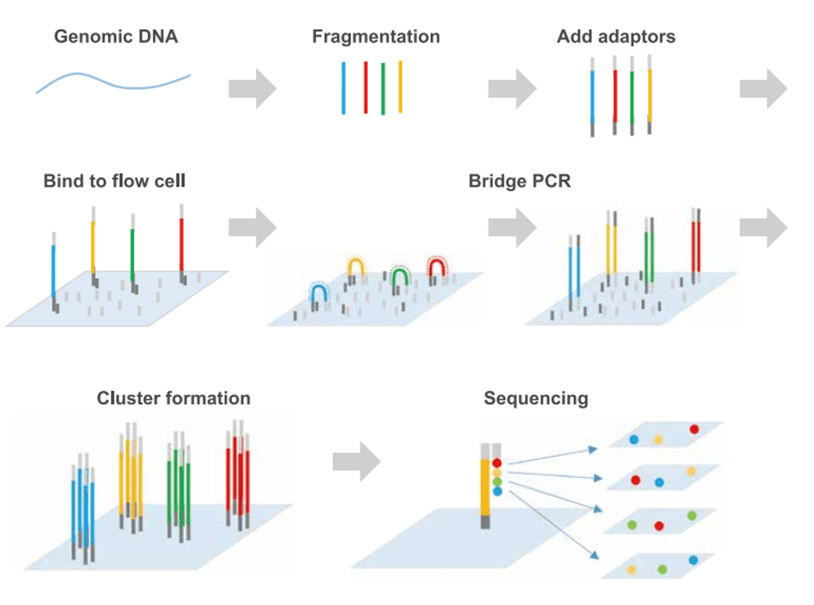
I - 2. Next generation sequencing
Illumina Sequencing
(2006, Solexa)
DNA fragment binding
Bridge amplification
Cluster formation
Fluorescent labeled dNTP(chemically modified 3’-OH)
Enzymatic cleavage to remove fluorescent dNTP
Go on ..
Flow cell

Slide 9
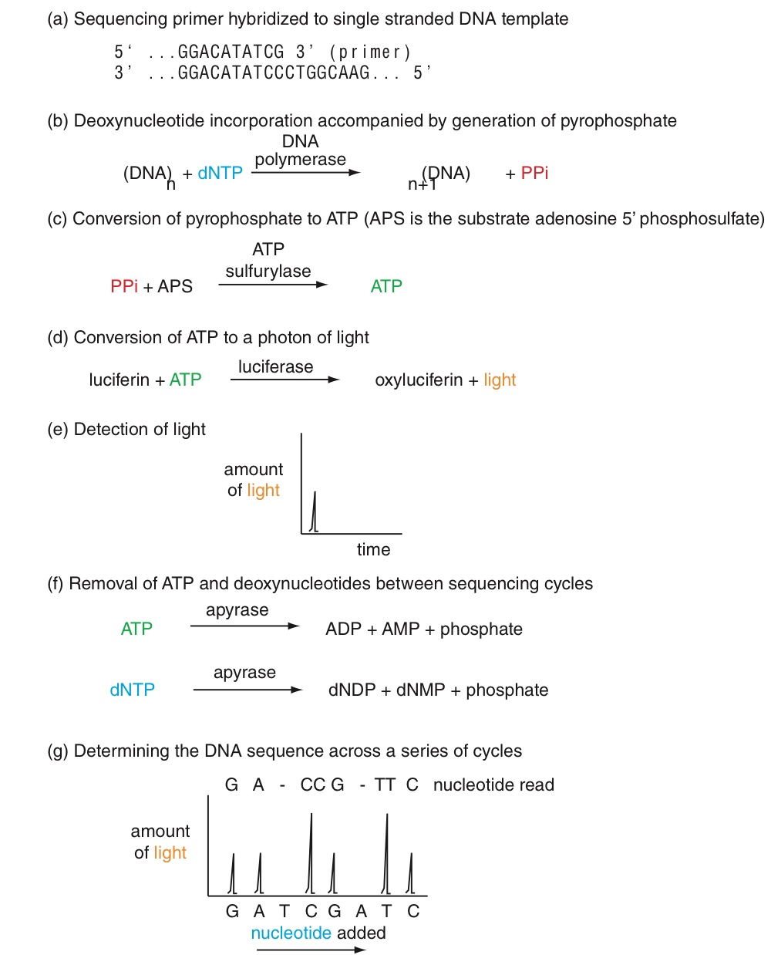
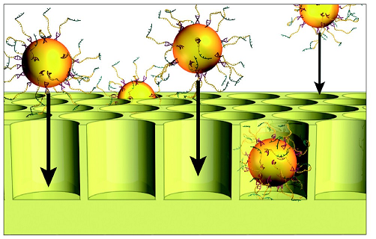
I - 2. Next generation sequencing
PyroSequencing
(2008 Rothberg)
DNA amplification(PCR)
DNA binding with bead & bead immobilized
Spreading specific dNTP(e.g. GTP)
If dNTP hybridization with DNA
Enzyme chain reaction > LIGHT
Sequencing by light detection

Slide 10
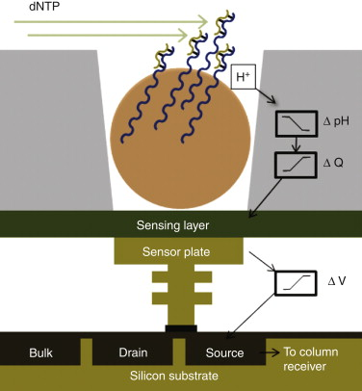
I - 2. Next generation sequencing
Ion Torrent Sequencing
(2011, Rothberg)
DNA amplification
DNA binding with bead & bead immobilized
When dNTP hybridization > pH changes
Sequencing by pH changing

Slide 11
I - 2. Next generation sequencing
 | Illumina | Pyrosequencing | Ion torrent
Advantage | Fast, Cheap No Homopolymer difficulty | Fast, Cheap High accuracy | Fast, Cheap High accuracy Less equipment needed
Disadvantage | Reads are short | Reads are short Homopolymer difficulty | Reads are short Homopolymer difficulty

Slide 12
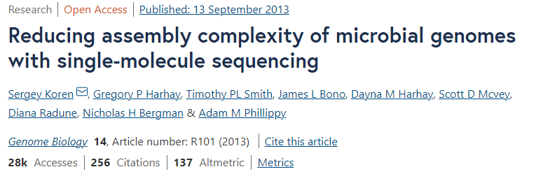
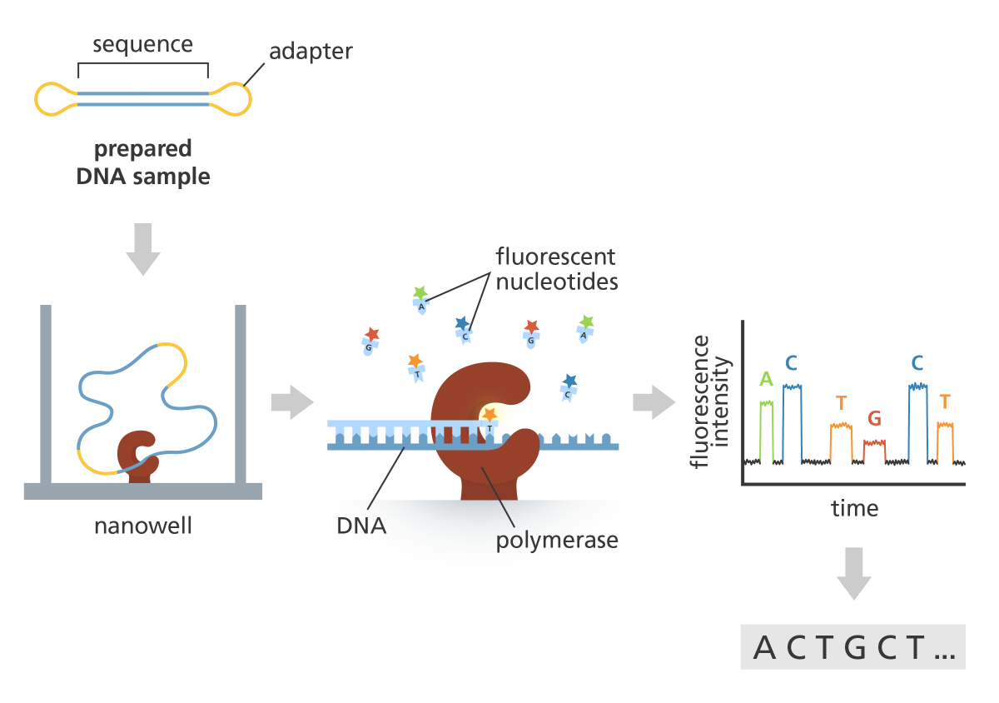
I - 3. Long read sequencing
PacificBioscience Sequencing
(2013)
No PCR
ZMW(Zero-mode waveguide)
DNA polymerase immobilized in nano well
SMRT (Single Molecule, Real-Time)
DNA go through polymerase
When fluorescence labeled dNTP hybridization, fluorescence dropped
ZMW detect fluorescence

Slide 13
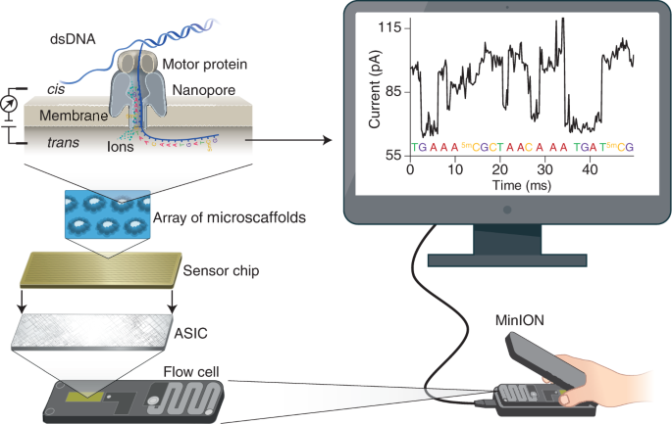
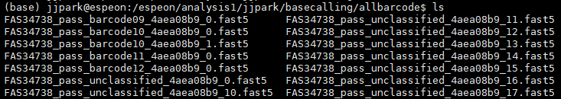
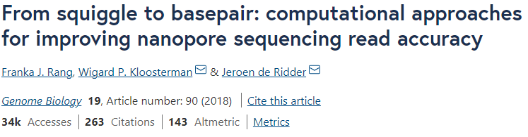
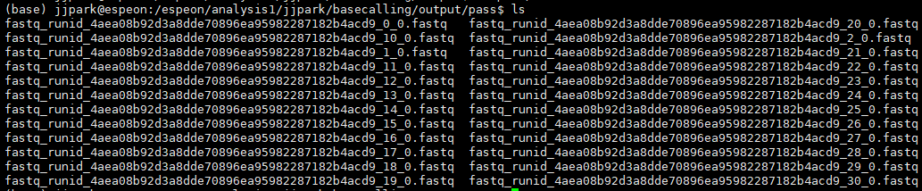
I - 3. Long read sequencing
Oxford nanopre Sequencing
(2015)
Membrane protein(α-hemolysin, MsPA, CsgG )
Membrane has electrical resistance, membrane protein attached to membrane
Motor protein(attached to membrane protein) make dsDNA to ssDNA
Constant voltage on nano pore
When base pass, electric current change, detecting electric current changing.

Slide 14
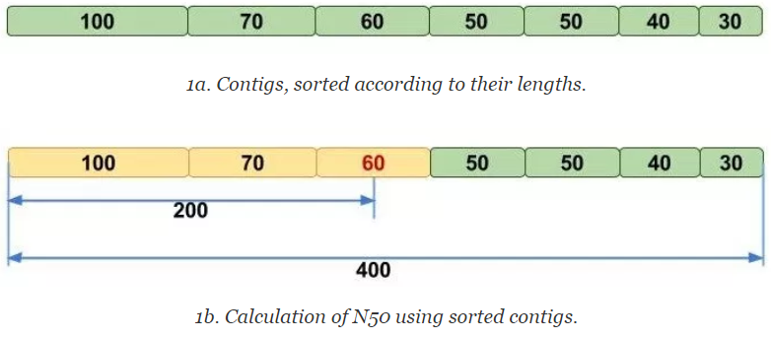
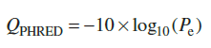
II - Definitions of terms for NGS data analysis
Q score(PHRED score)
N₅₀
P_{e} : Base calling error rate
Q₂₀ : 99% accuracy (1 in 100 error)
Q₃₀ : 99.9% accuracy (1 in 1000 error)
The length in base pairs such that scaffolds of this length or longer include 50% of the base in the assembly

Slide 15
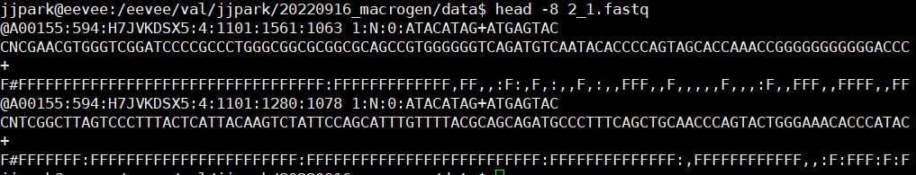
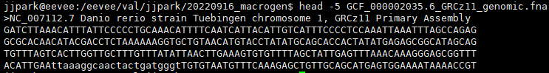
II - Definitions of terms for NGS data analysis
FASTQ format
FASTA format
First line : Starts with ‘@’, read specific information.
Second line : Sequence information (ATGC)
Third line : Starts with ‘+’
Fourth line : Quality score for each base(ASC II)
First line : Starts with ‘>’, read specific information.
Second line : Sequence information (ATGC)

Slide 16
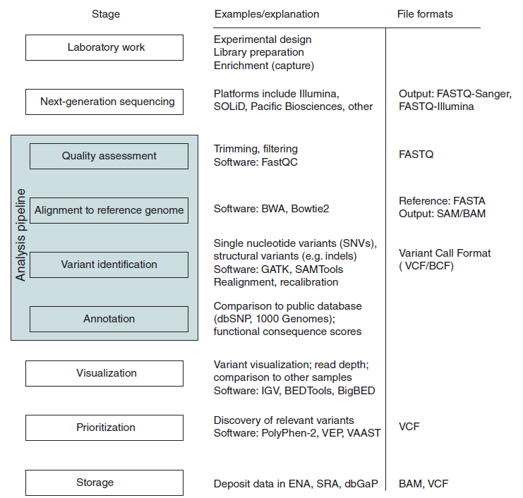
II - Workflow of NGS data analysis
Quality assessment
Genome
Assembly
Alignment

Slide 17
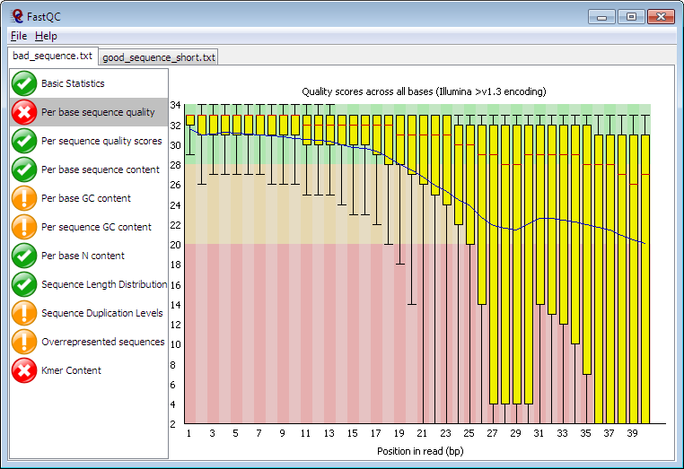
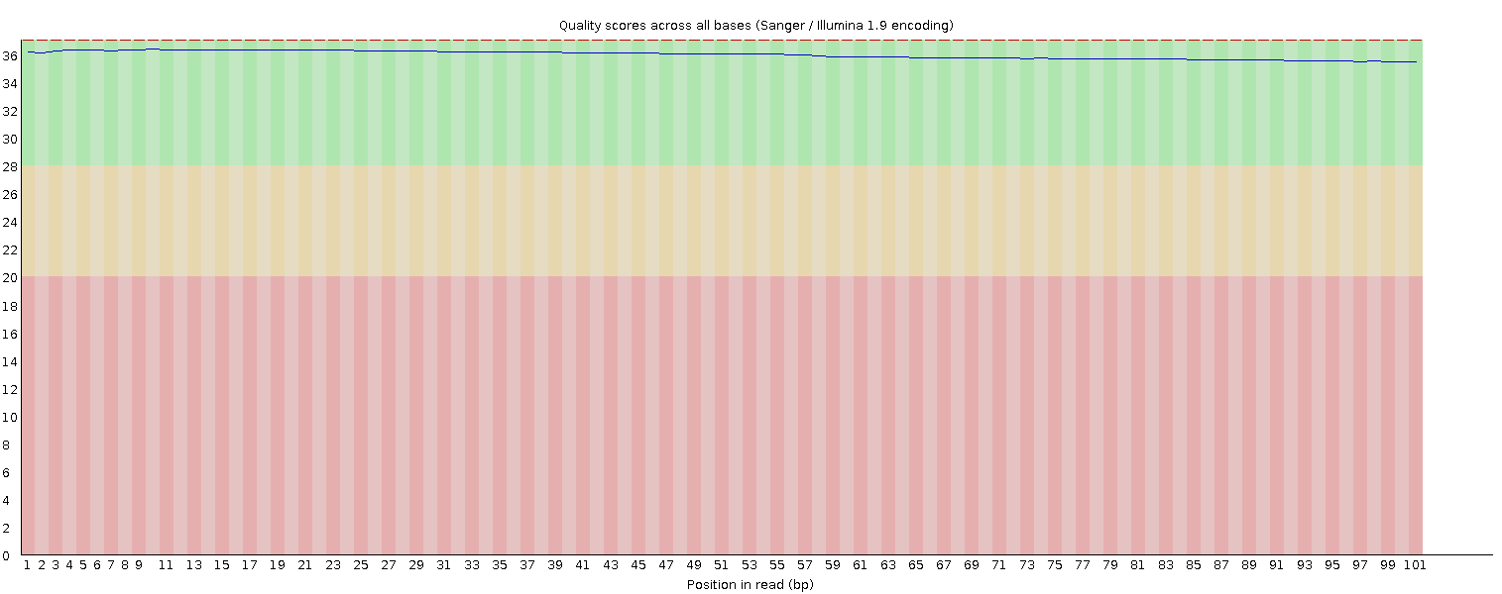
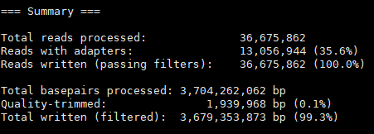
II - Workflow of NGS data analysis
Fast QC
X axis : gene position
Y axis : quality score
Simple statistics
GC contents
Q score
Adapter trimming (Trimgalore)

Slide 18
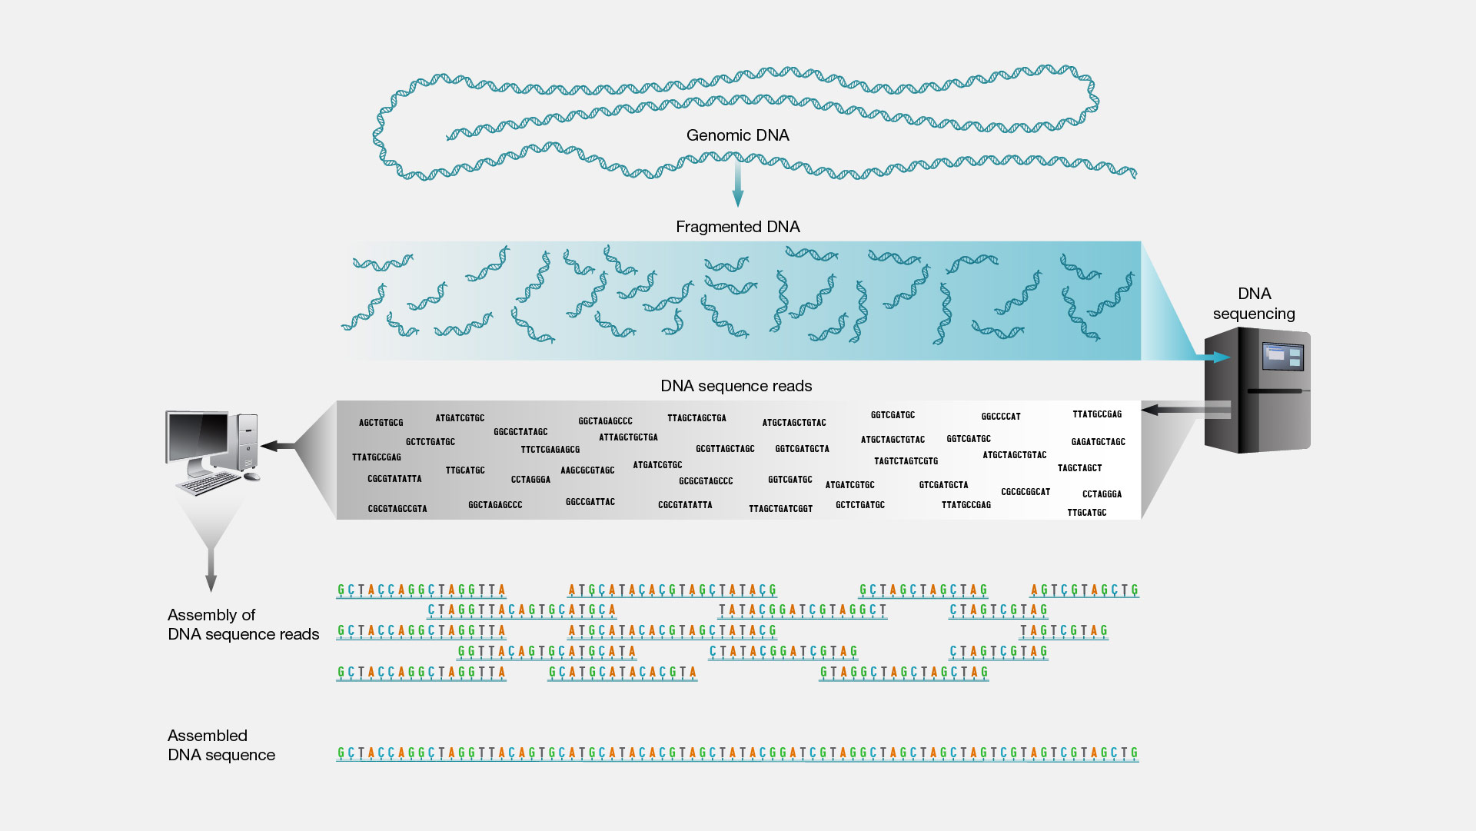
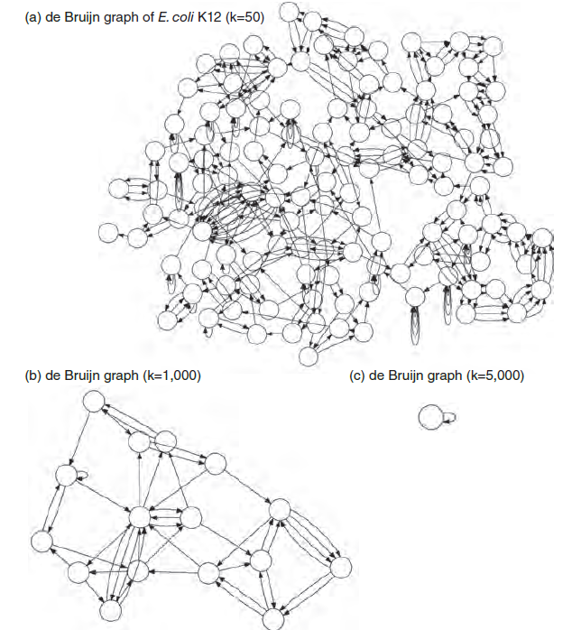
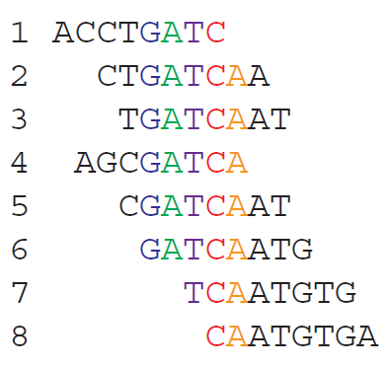
II - Workflow of NGS data analysis
Genome assembly
Overlap/layout/consensus approach
De Bruijn graph
Many soft wares
ABySS, SOAP denovo …

Slide 19
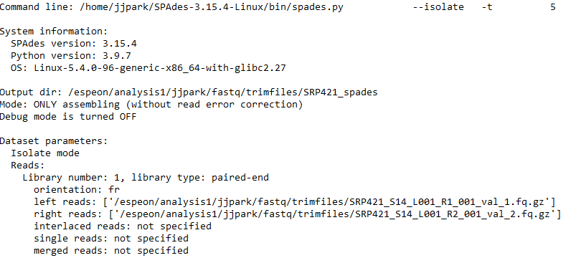
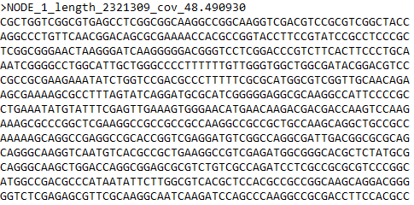
II - Workflow of NGS data analysis

Slide 20
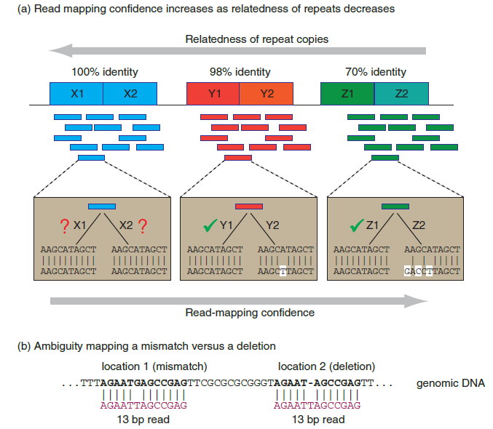
II - Workflow of NGS data analysis
Genome alignment
Challenges
Read are shorts
May have multiple genomic locations
Repetitive regions
INDELs or mismatch?

Slide 21
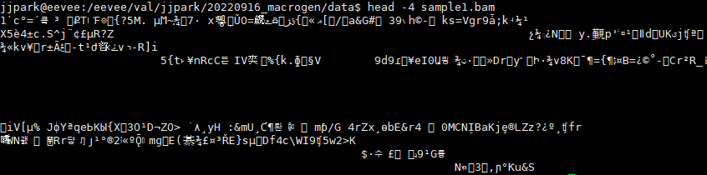
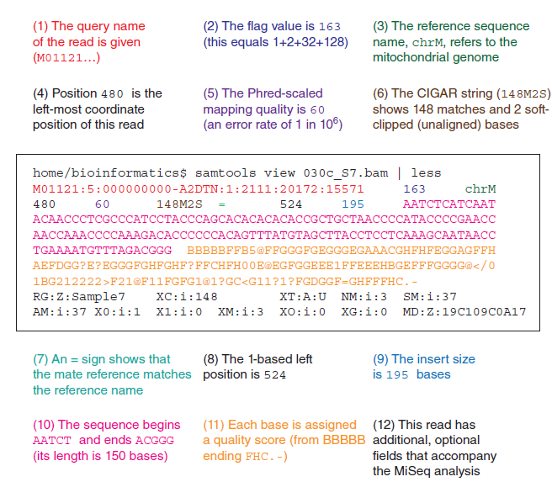
II - Workflow of NGS data analysis
SAM format files
Non-binary file
Very larger than BAM
BAM format files
Binary file
Standard format for alignment sequence

Slide 22
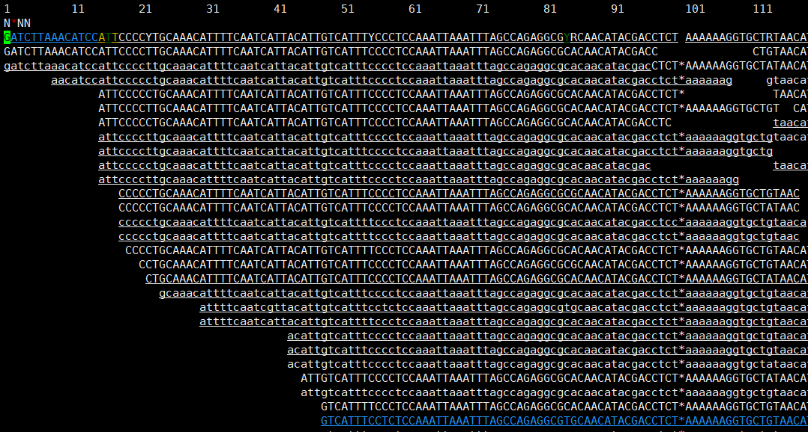
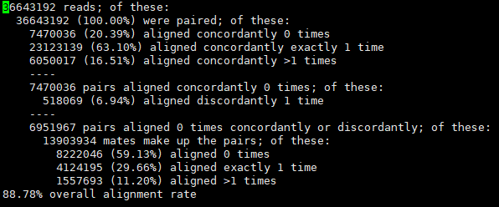
II - Workflow of NGS data analysis
SAMtools tview sample1.bam
Genome alignment in practice
Indexing can be needed
SAMtools for handling BAM

Slide 23
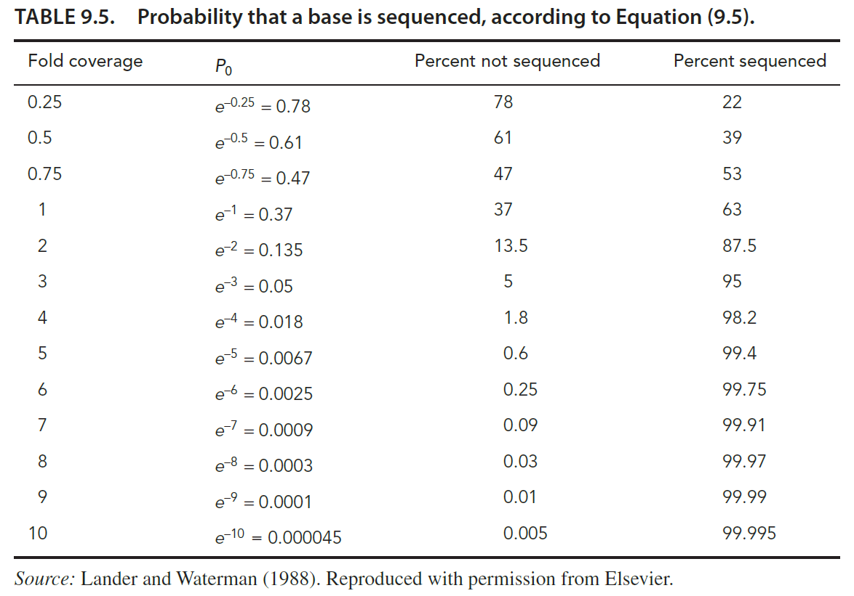
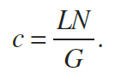
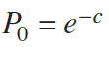
II - Workflow of NGS data analysis
Read depth
(1988, Lander and Waterman)
NGS can get a lot of copy of reads
Can improve accuracy by overlapping reads
c, coverage means accuracy
c = coverage
L = average length of each read
N = number of reads
G = genome size

